Slide 1


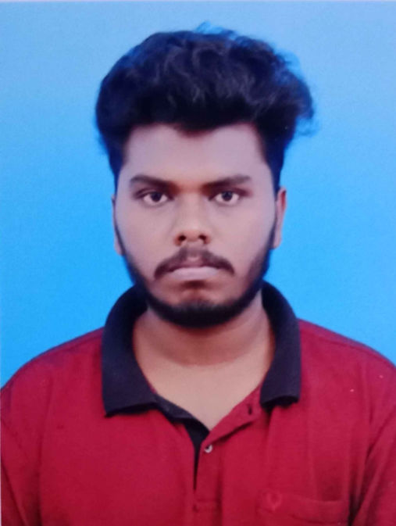

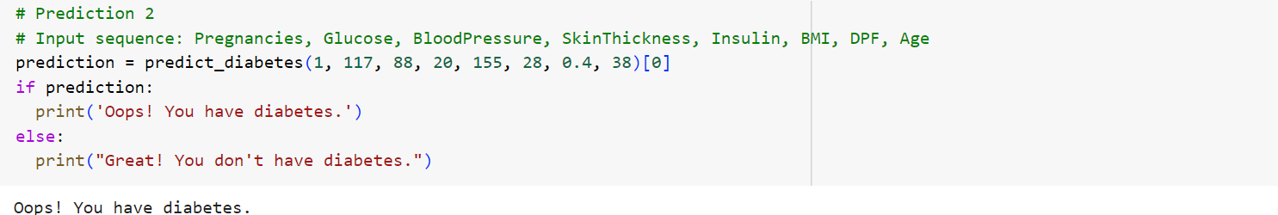
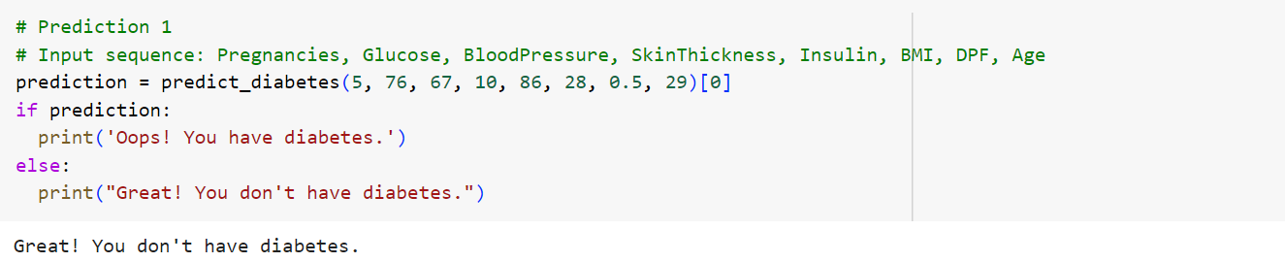
Diabetes Prediction Using Machine Learning
Program Feedback
Project Short Summary
I am deeply grateful for this opportunity, which has significantly broadened my understanding and ignited my passion for Data Science and AI. The experience has provided me with valuable clarity and direction for pursuing a career in this exciting field. I would like to extend my sincere thanks to Uzma mam and the entire Edunet Foundation team for your outstanding support and resources. Your guidance has been instrumental in setting me on a successful path.
This project aims to predict diabetes using machine learning, leveraging data from medical records to forecast diabetes onset. By analyzing patient data and applying the Random Forest Classifier, we can achieve high accuracy in predictions, aiding early diagnosis. This project utilizes Pandas for data preprocessing and visualization to provide comprehensive insights into diabetes risk factors, enhancing patient management and outcomes.
Muthukumaran E
muthukumarane2002@gmail.com
Periyar University,
Salem
#skillsbuild

